Slide 1


In season forecasting
Part 1: Weather data
Part 2: In season yield estimation

Slide 2

Part 1:
In-Season yield prediction weather inputs
1 – Precipitation data
2 – Extended Forecasts
3 – Seasonal Forecast

Slide 3
Precipitation data sources
Vast majority of Maize crop in Ghana is rain-fed so need source of precipitation data to drive the WOFOST model
Options include EO observation based products (TAMSAT, CHIRPS etc.) and NWP model outputs in forecast or reanalyses
Analysed different data types for range of agro-met Zones in Ghana to compare characteristics and understand impacts on crop model outputs
I will expand a bit on what the ERA and TAMSAT datasets are

Slide 4
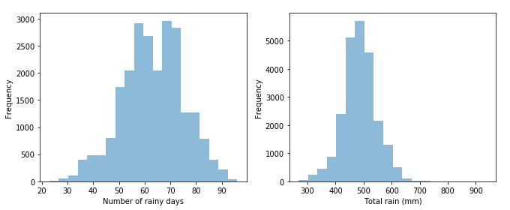
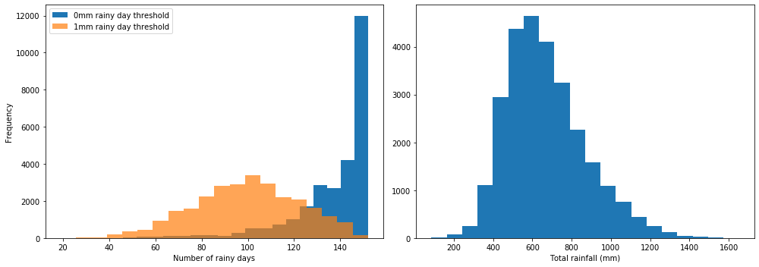
Precipitation – ERA vs TAMSAT
Distribution of two rainfall statistics per season in TAMSAT and ERA5 over Ghana for the data record from 1983 to 2019
ERA5 shows unrealistic number of rainy days (with v small amounts of rain). Can be adjusted by setting a rejection threshold of ~1mm
Distributions broadly tach with typical ~ 80 rainy days and ~500mm per season.
Meteosat/TAMSAT
ERA5 Reanalysis

Slide 5
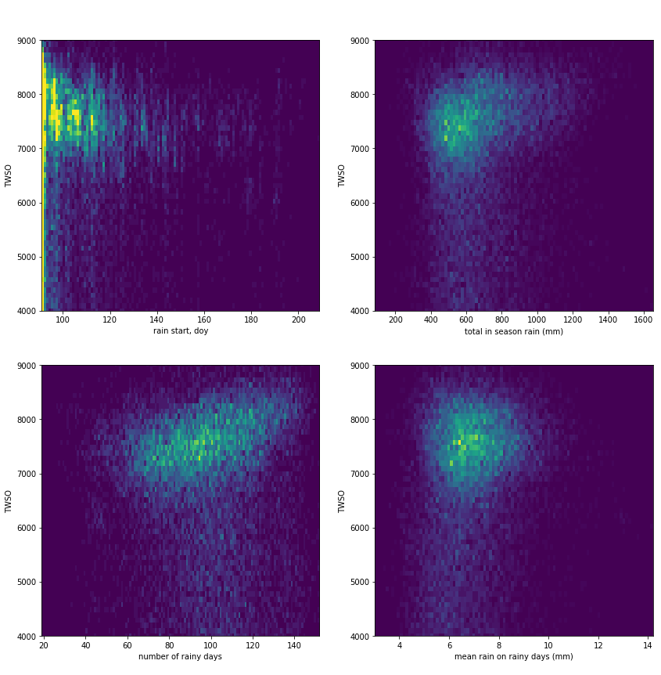
Precipitation – sensitivity of WOFOST to rainfall metrics
Simulated WOFOST TWSO with a standard calibration for West Africa. Driven by ERA5 rainfall for seasons 1979-2019 for each model cell in Ghana
Outputs are relatively insensitive to total rainfall in season (top right).
More sensitive to rainfall start date (top left) and number of rainy days (bottom left).

Slide 6
Weather forecast data
Brief description of the ECMWF forecast data, characteristics, availability
Seasonal forecasts
Short term forecasts

Slide 7
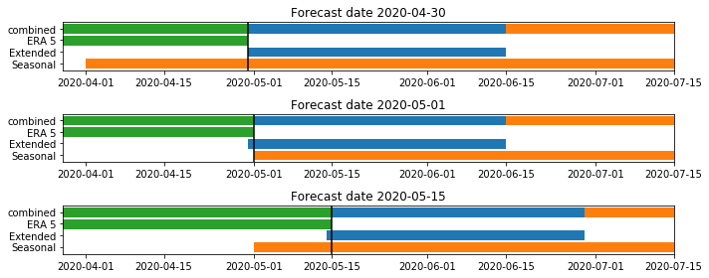
Combination of weather driver inputs
Simulations to measure the impacts of uncertainty in different types of forecasts for driving WOFOST were undertaken
System constructed to patch together retrospective ERA5, extended weather forecast and seasonal forecast (all ECMWF sourced)

Slide 8
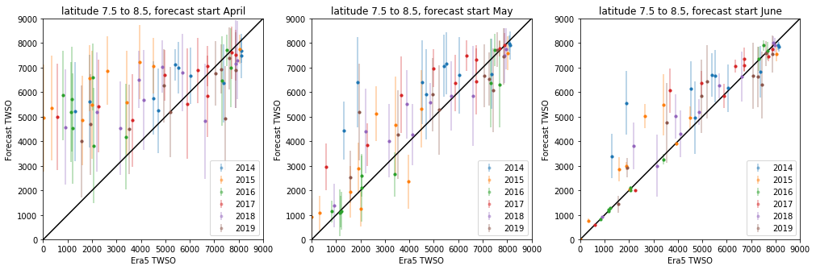
Impact on yield modelling of seasonal forecasts
WOFOST simulations run for years 2014-2019, for mid-latitude band Ghana
Based on ERA5 driving data as “truth”. ERA 5 substituted with ECMWF seasonal forecast at the start of April (left), May (middle), June (right), when compared with ERA5 through the whole season
Seasonal forecasts generally result in overestimation of TWSO
Significant predictability May, though some years are problematic (eg 2014)

Slide 9
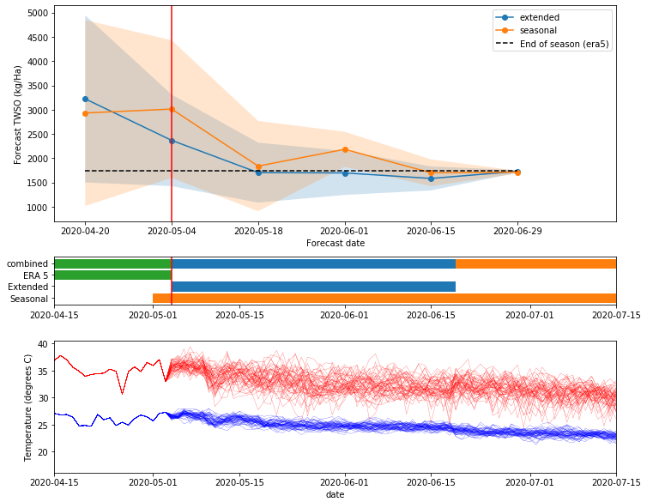
Combining extended and seasonal forecasts
Simulations run merging ERA5 reanalysis with forecasts starting at different points in the season
Extended forecast gives good performance starting in early may
Ensemble of forecasts
Max and Min
temperatures

Slide 10
Part 2: In-Season yield prediction application
1 – Components of in-season forecasting
2 – EO constraint mid season
3 – Crop model, EO and weather forecasts combined

Slide 11
Combine EO with crop model
Outline components that go into in season:
Wof. Ens derived from calibrated crop param dists
LAI derived from satellite observations
Matching of LAI to ensemble profiles up to forecast date
Drive matched ensembles forward with forecast weather data
Obtain an ensemble of possible yield outcomes
Different ways to construct each component (we have used a different approach to what’s been shown) but they come together this way

Slide 12
Combine EO with crop model
WOFOST crop model outputs the Total Weight of Storage Organs (TWSO) which is a proxy for yield.
Model requires hundreds of parameters that describe crop development.
We use another output of WOFOST: Leaf Area Index (LAI) to constrain these crop parameters .
We retrieve LAI from S2 using machine learing and S1 observations using a data assimilation scheme (KaFKA)
Use the EO derived LAI to constrain WOFOST LAI and hence crop parameterisation to improve yield modelling.

Slide 13
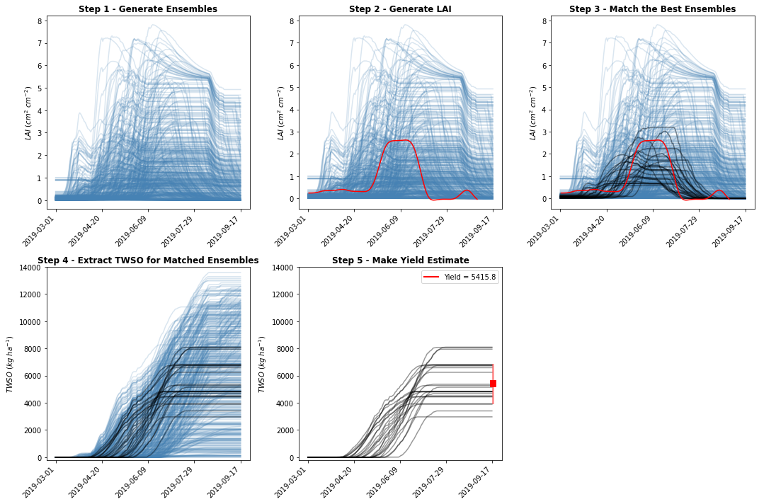
Combine EO with the crop model
Generate ensemble of possible WOFOST realisations
Compare to EO derived LAI
Find WOFOST runs that best match observed LAI
Extract yield estimate and uncertainty from matched runs

Slide 14
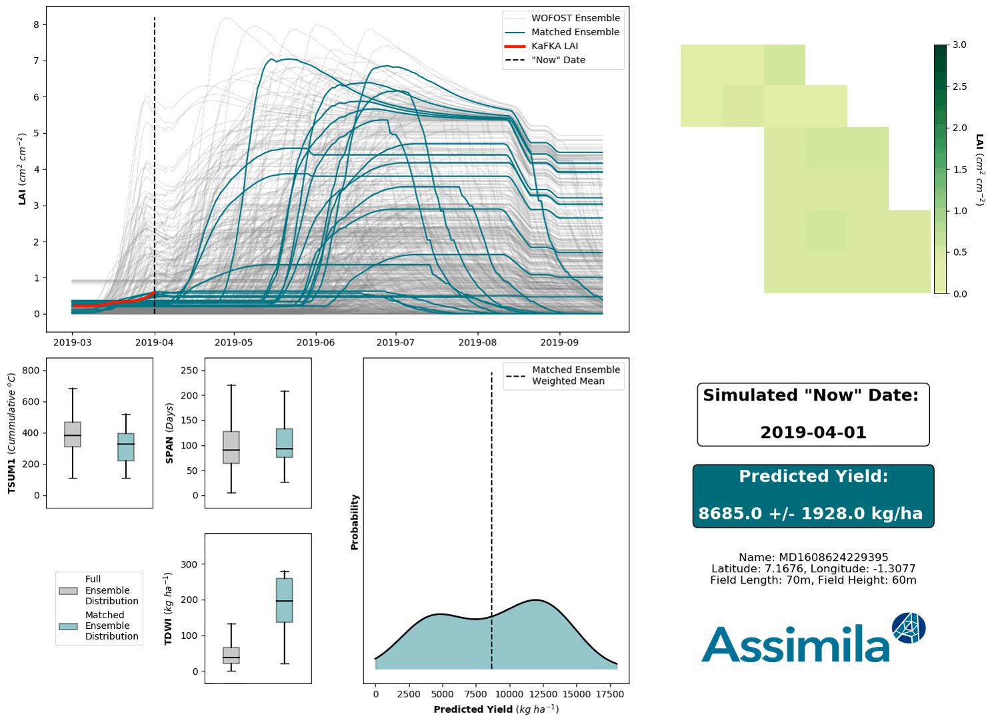
Matching EO part way through the season
For in season yield forecasting, EO data is only available up to forecast date.
We simulated in season EO – crop model matching with partial LAI profiles (and ERA weather).
As more EO data becomes available, the forecast yield becomes more certain.
LAI in field
EO matching process
Selected model parameters
Probability distribution of predicted yield

Slide 15
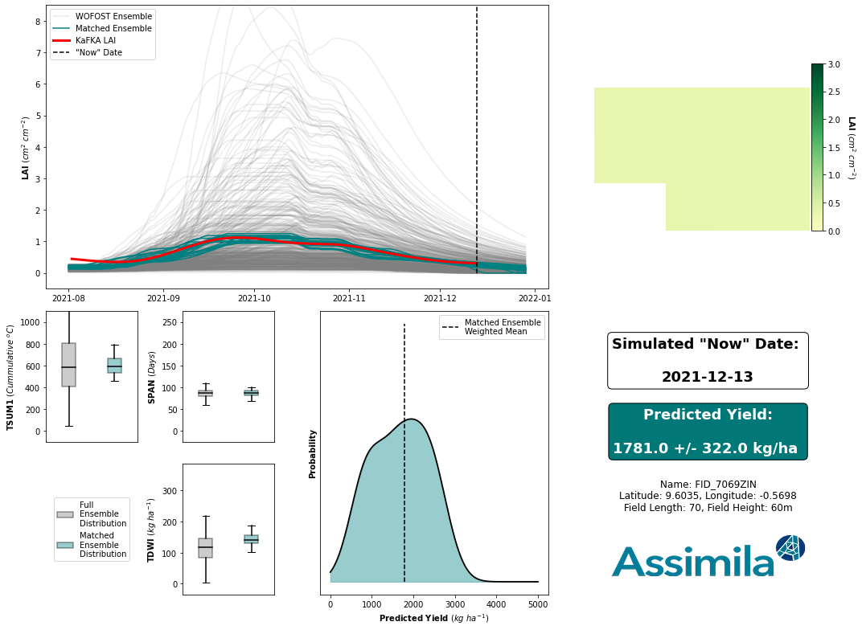
Matching EO part way through the season
For in season yield forecasting, EO data is only available up to forecast date.
We simulated in season EO – crop model matching with partial LAI profiles (and ERA weather).
As more EO data becomes available, the forecast yield becomes more certain.
LAI in field
EO matching process
Selected model parameters
Probability distribution of predicted yield

Slide 16
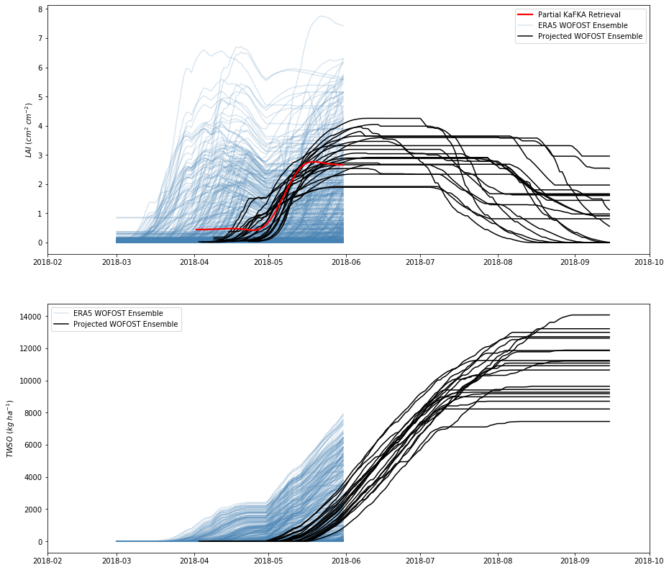
Crop model, EO and weather forecasts combined
We prototyped a system to combine the crop model with EO data and weather forecasts to predict crop yield at harvest.
EO derived LAI is matched to potential WOFOST realisations up to the date the forecast is made.
The best model runs are then driven forward in time with seasonal weather forecasts.
TWSO extracted from the crop models to predict harvest yield and uncertainty.

Slide 17
Conclusions

Slide 18
Outputs & Impacts
Review of rainfall datasets (historic and forecast) and assessment of the impact of rainfall metrics on crop model yield.
System for producing weather driver data for the WOFOST crop model combining era 5 with extended weather forecast data.
System to constrain crop model with EO derived LAI
System to combine crop model with EO derived LAI and weather forecasts to forecast harvest yield during the growing season.
Development work fed into and enabled new project for UK farmers on benchmarking and crop modelling.

Slide 19

Thank you

